Slide 1
HEALTH WALLET

Slide 2
ABSTRACT
The objective of the project is to provide a complete healthcare software solution for patient relationship, doctors appointment, health record management system.
The E-health care management system exploits a centralized database architecture that is fully interoperable with industry standard databases. This allows you to build upon the strengths of your existing platform and applications with minimal effort.
The online doctor’s appointment application will allow the patients to take the appointment and also to track the patient details without any difficulty. The user needs to register through this application to take the appointments. This application will automatically provide new appointments to the people.
The patients can register to this application by entering all the profile details. After that they can take the appointment from the particular doctor without any difficulty. The patients can check their appointment details, treatment and prescription details.
The module can also send and receive messages from admin, patients, hospitals and doctors online.

Slide 3
The main features are ;
• To automate the appointment system for a local outpatient hospital.
• To give the hospital the ability to track patients on a small scale.
• To manage schedules appointments for patients.
• To allow quick access to patient health records.
• Accepts E-prescriptions from different departments and consulting doctors.
• Provide accurate reports of consumption details.

Slide 4
EXISTING SYSTEM
The existing system takes a long time to configure and difficult to learn.
Repeated test results in different hospitals.
Offers inflexible reports that are difficult to generate.
Can’t be modified to meet their own needs; or requires expensive maintenance plans and updates.
The existing manual process of maintaining a patient record, doctor scheduling info, day to day activities and billing is tough.

Slide 5
DRAWBACKS OF EXISTING SYSTEM
The current system is difficult to learn.
It is very expensive because of the unnecessary checkups taken by the hospitals.
Individual hospitals provides unique patient ID for that hospital only.
It doesn’t have the flexible reports.
More manual hours need to generate required reports (paper reports).
It is difficult to manage historical data which needs much space to keep all the previous years records etc.

Slide 6
PROPOSED SYSTEM
This Health Wallet application is an online Healthcare Management service provider with easy to use customizable options.
The application is accessible from anywhere for all staff of the hospital.
It will basically lessen the manual work and improves the quality of maintaining records and other information related to doctors or patients etc.
It reduces time frame in adding any info related to hospital and thereby reduce the complexity too.
This allows you to build upon the strengths of your existing platform and applications with minimal effort.

Slide 7
FUNCTIONS OF PROPOSED SYSTEM
• HOSPITAL MODULE
• DOCTORS CONTROLLING MODULE
PATIENT CONTROLLING MODULE
• ELECTRONIC MEDICAL RECORDS MANAGEMENT
• HEALTH WALLET

Slide 8
HARDWARE REQUIREMENT
1. Processor : Dual Core 1.60 GHz or higher
2. Hard disk : 500 GB
3. RAM : 4GB
4. Monitor : 17” Color Monitor
5. Mouse : Microsoft
6. Keyboard : Microsoft multimedia keyboard

Slide 9
SOFTWARE REQUIREMENTS
1. Operating System : Windows 8 or higher
2. Framework : Microsoft .Net Framework
3. Front End : HTML,CSS,JavaScript,ASP.Net
4. Language : C#
5. Back end : Microsoft Sql Server 2008 or higher
6. Documentation : Microsoft Word 2007 or higher

Slide 10
MODULES
There are 4 Modules ;
Admin
Hospital
Doctor
Patient

Slide 11
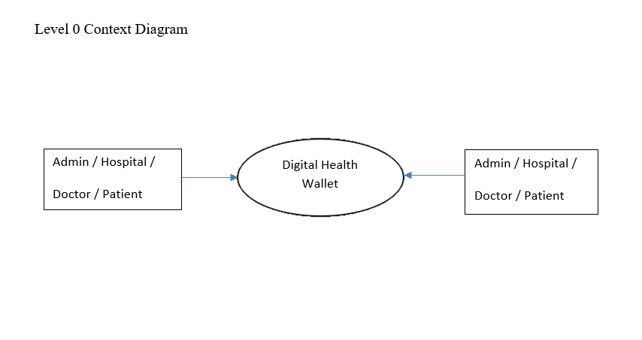
PROJECT DATA FLOW DIAGRAM
Context Level / Level 0

Slide 12
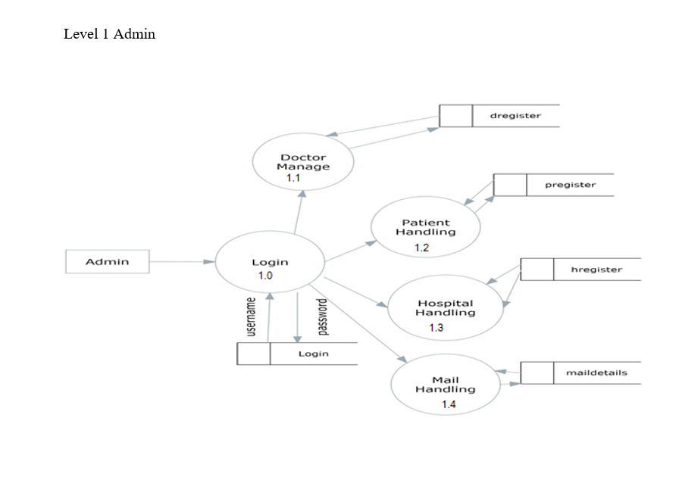
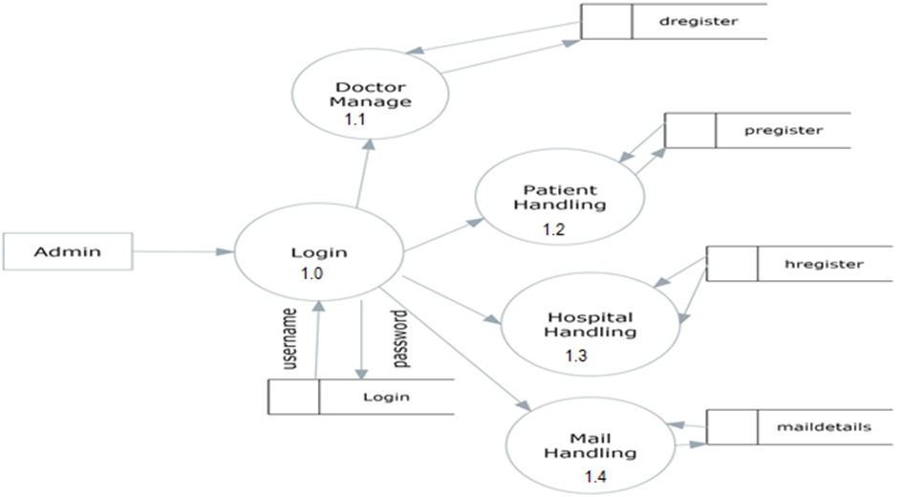

Slide 13
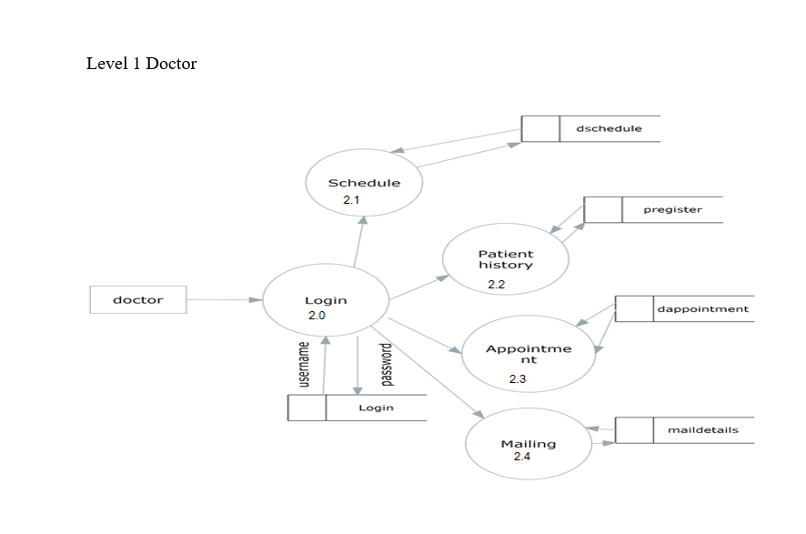

Slide 14
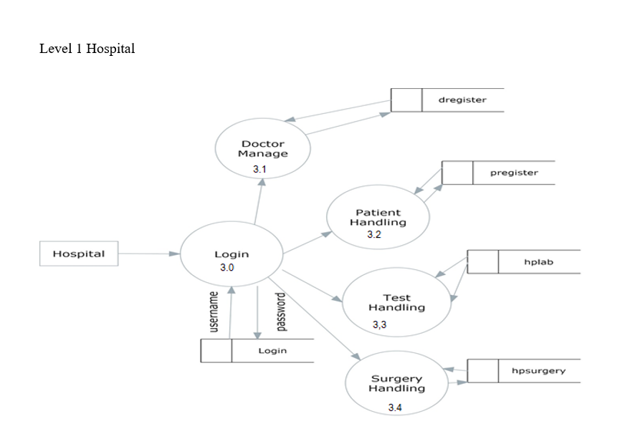

Slide 15
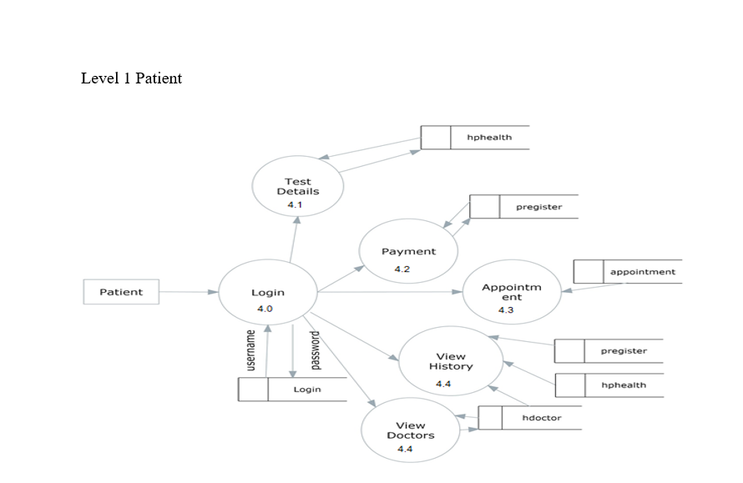

Slide 16
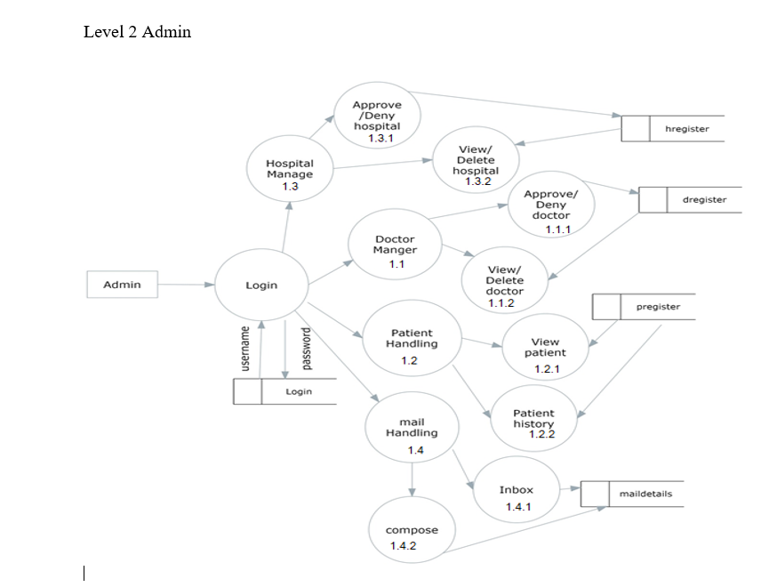

Slide 18
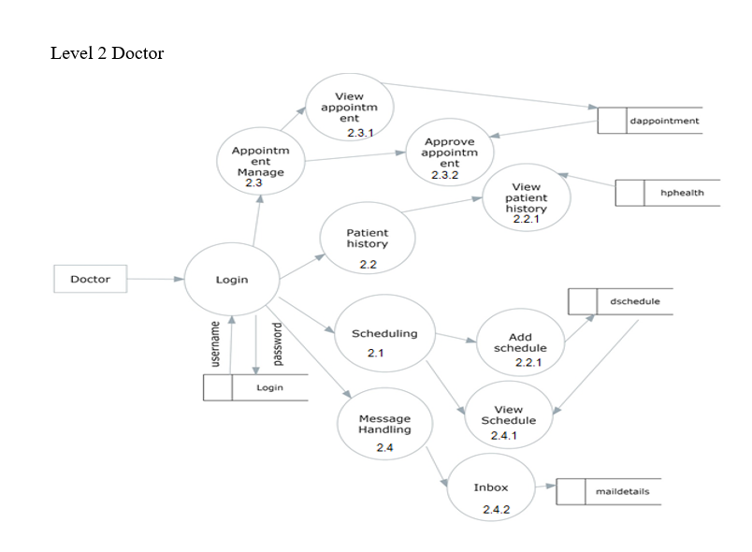

Slide 19
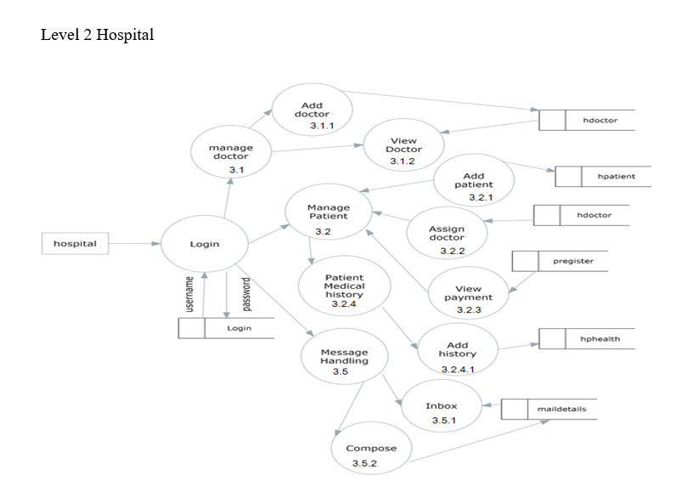

Slide 20
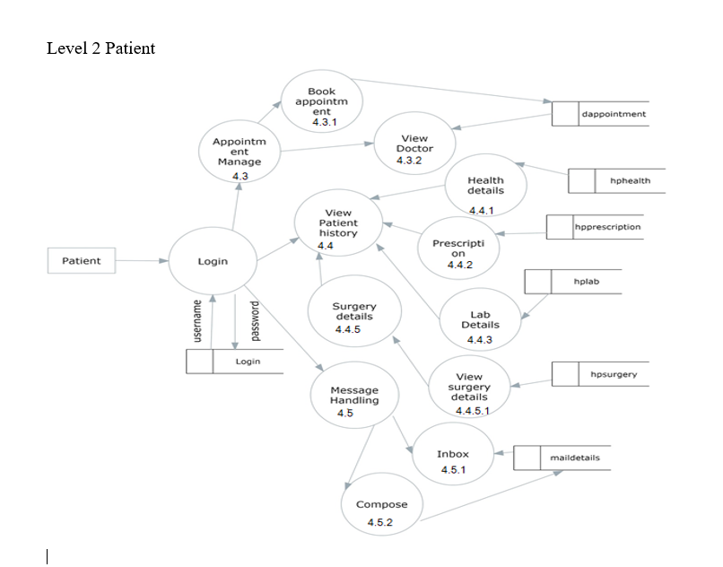

Slide 21
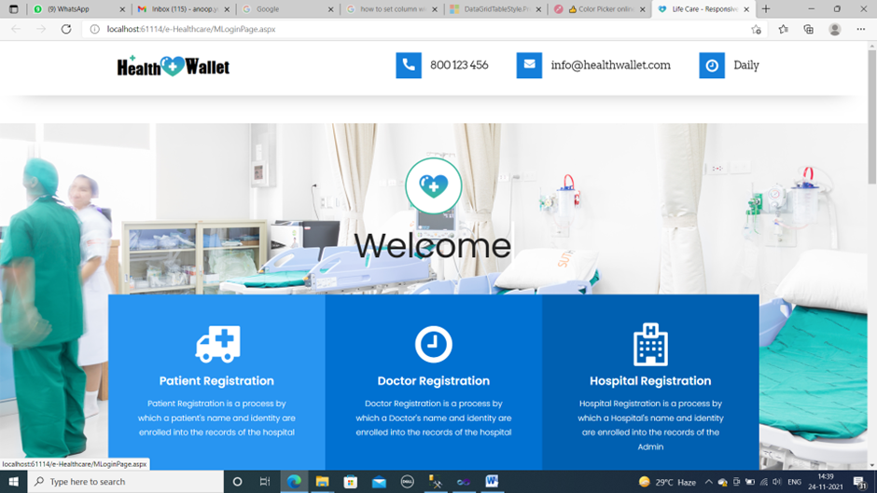
SCREENSHOTS :
Login

Slide 22
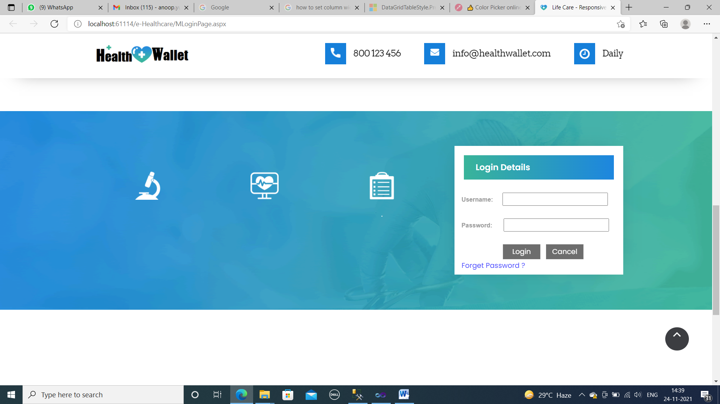

Slide 23
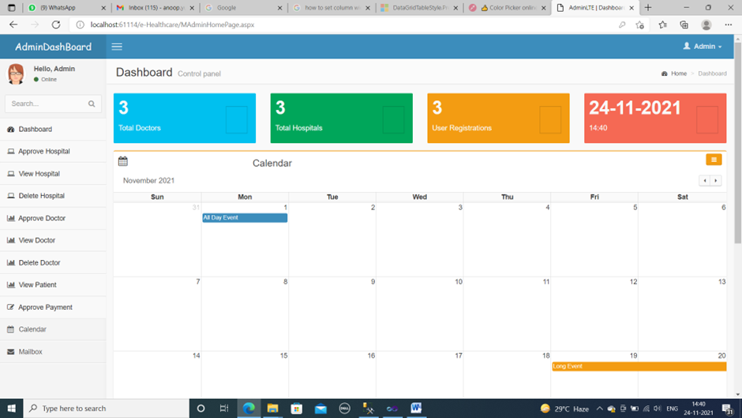
Admin home page

Slide 24
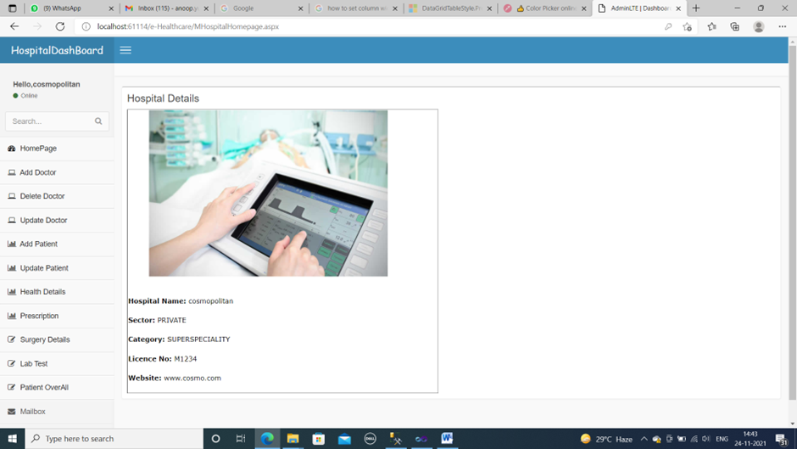
Hospital Home Page

Slide 25
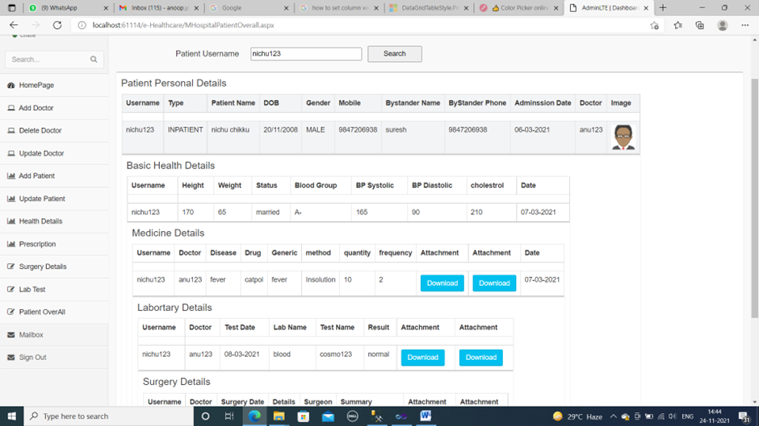
Patient overall Details

Slide 26
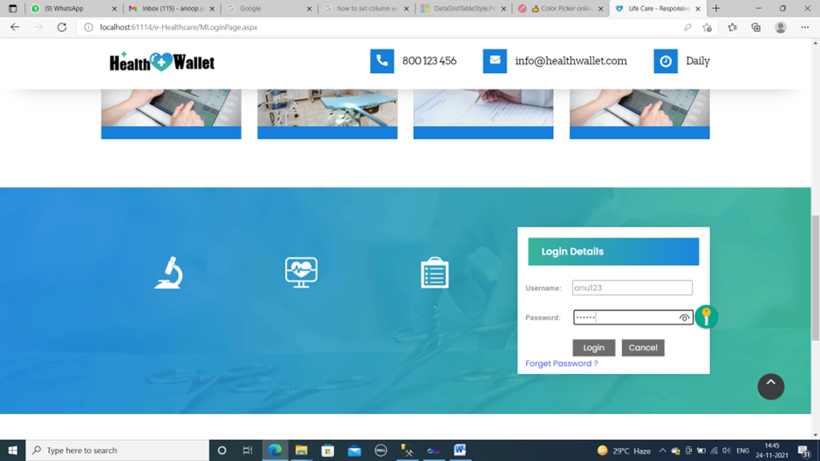
Doctor Login

Slide 27
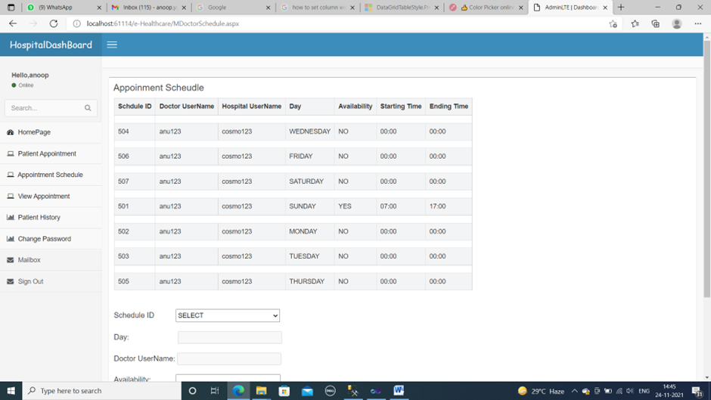
Appointment Schedule

Slide 28
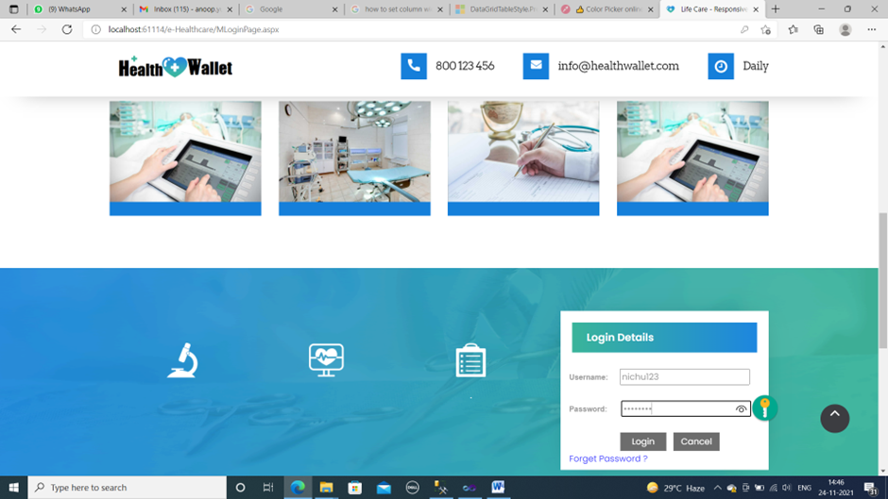
Patient Login

Slide 29
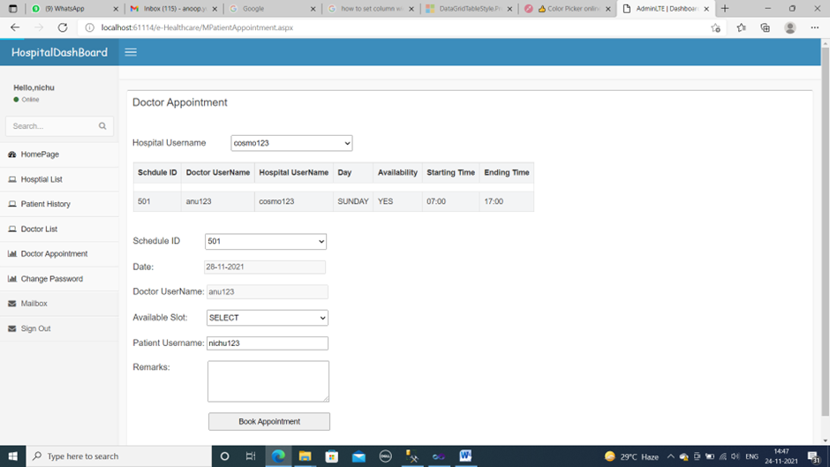
Book Appointment

Slide 30
FUTURE ENHANCEMENT
Implement this application world-wide.
AI-powered, bedside virtual care assistant for a patient that can answer or direct queries to the most appropriate person at the hospital.
Add lab, clinic registration and their services.
Provide appointment for home consultation.
Charity handling.
Online pharmacy software to enable pharmacists streamline functioning of their medicinal stores.

Slide 31
CONCLUSION
Hence forth the development of the Health care application is in progress and the automation testing of the developed modules is done through the hybrid framework without the intervention of human. When this comes into usage it is mainly to reduce the human effort in retesting the application. Normally when an application is in developing stage it may be having many customizations according to the need of the application so always testing may consume lots of effort and time. Therefore, testing becomes easier with this framework. EMR efficiency (Eliminates Medical Errors) application improves the work flow. Improves Patients Satisfaction. Improves Patient safety and Quality of care for patients. Deliver standardized patient care.

Slide 32
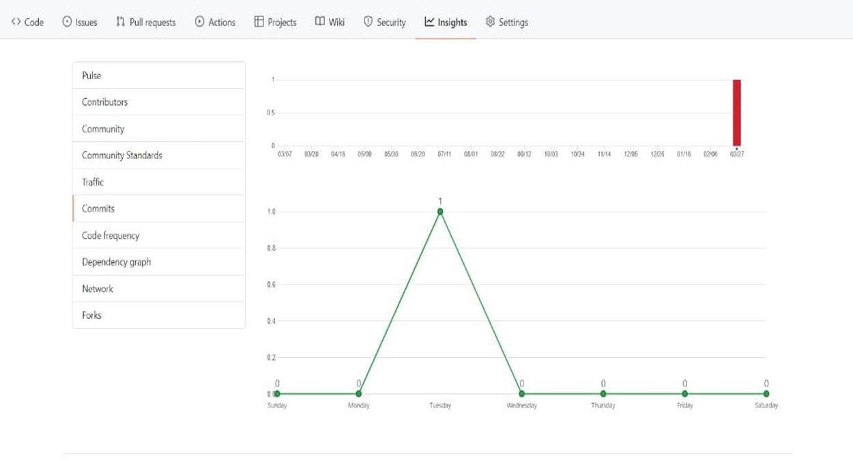
GIT HISTORY

Slide 33
THANK YOU…

